Slide 1
Using Newton’s Laws

Slide 2
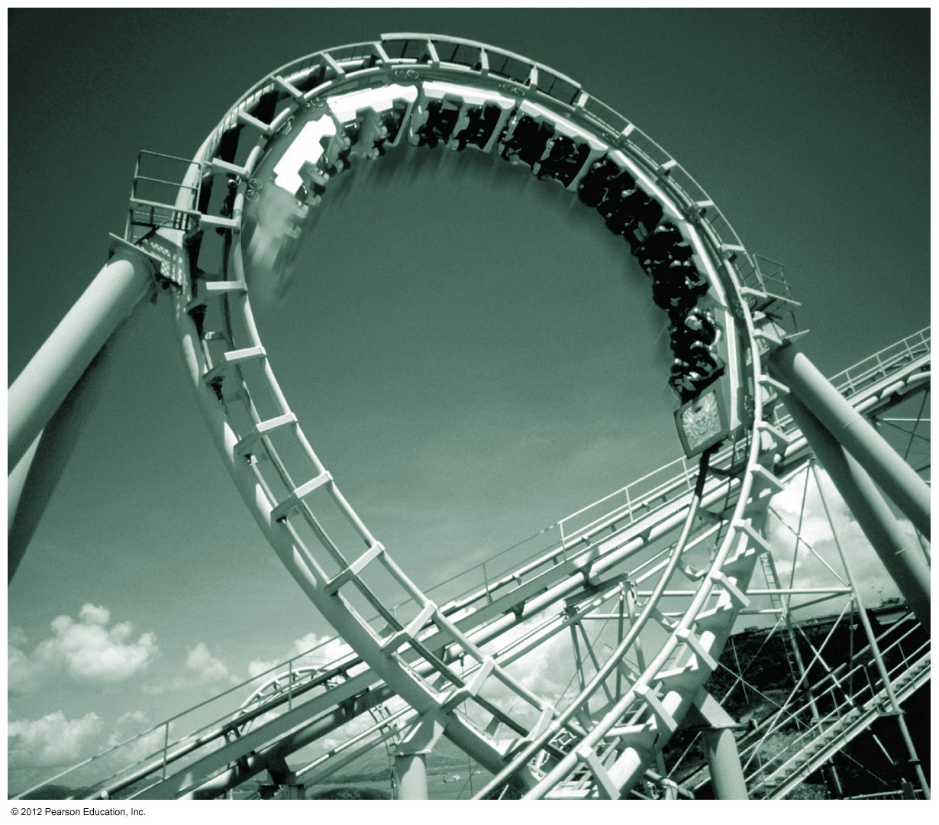
In this lecture you’ll learn
To use Newton’s second law to solve problems involving
Objects moving in two dimensions
Multiple objects
Circular motion
Frictional forces
And the nature of friction

Slide 3
Newton’s Second Law
Using the law
Set up
Sketch (2) Free Body Diagrams (for each object) (3) Coordinates
Solve
(4) Equations for each components

Slide 4
Conditions of Equilibrium for a Particle
T
N
m
m
F

Slide 5
Conditions of Equilibrium for a Particle
y
N
y
N
m
m
m
x
x

Slide 6
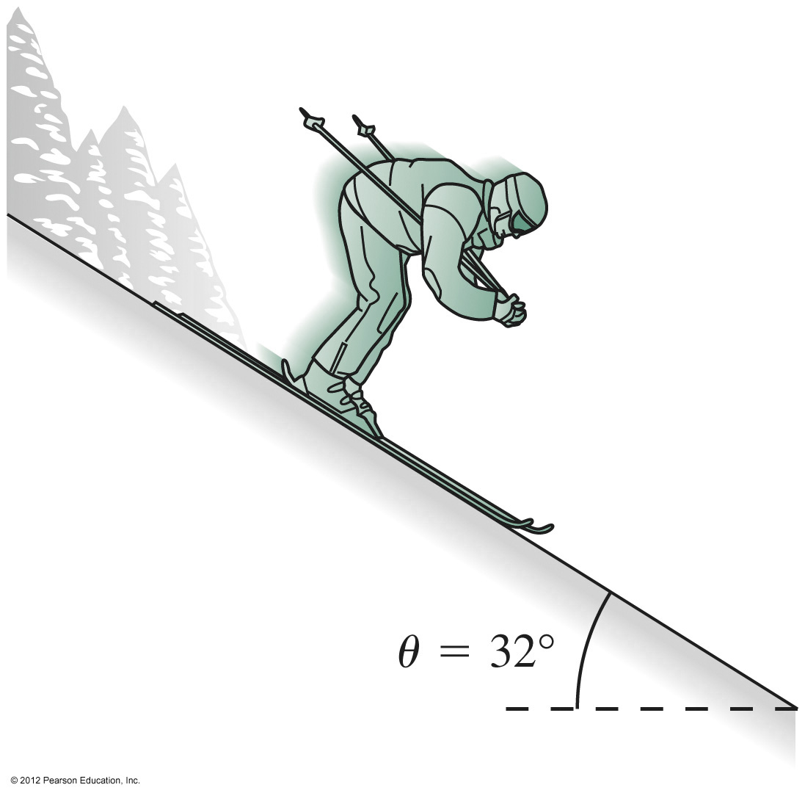
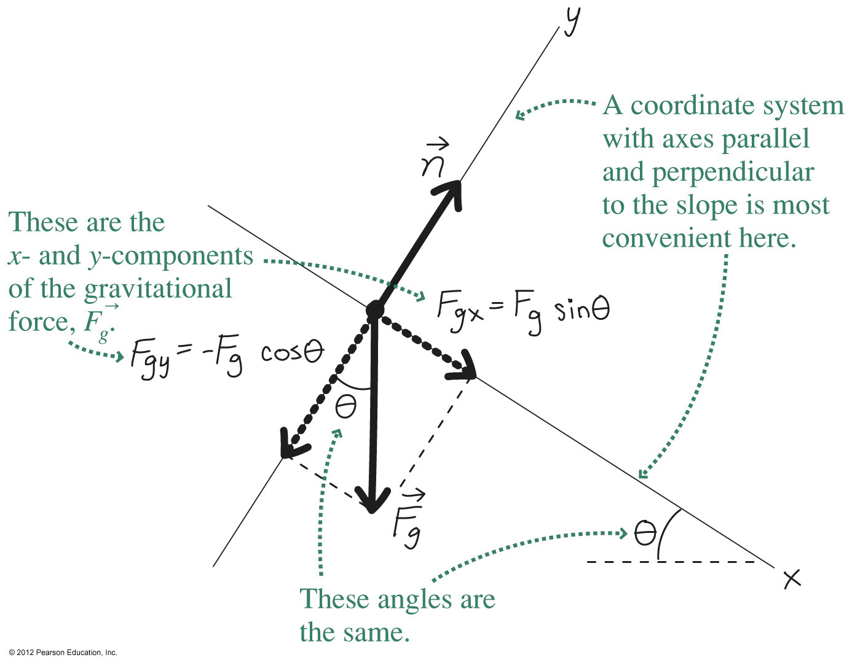
A Typical Problem: What’s the skier’s acceleration? What’s the force the snow exerts on the skier?
Physical diagram:
Free-body diagram (frictionless):
Newton’s law:
In components:
x-component: mg sinθ = ma
y-component: n – mg cosθ = 0
Solve (with m = 65 kg and θ = 32 °) to get the answers:
a = g sinθ =(9.8 m/s²)sin32° = 5.2 m/s²
n = mg cosθ =(65 kg)(9.8 m/s²)cos32° = 540 N

Slide 7
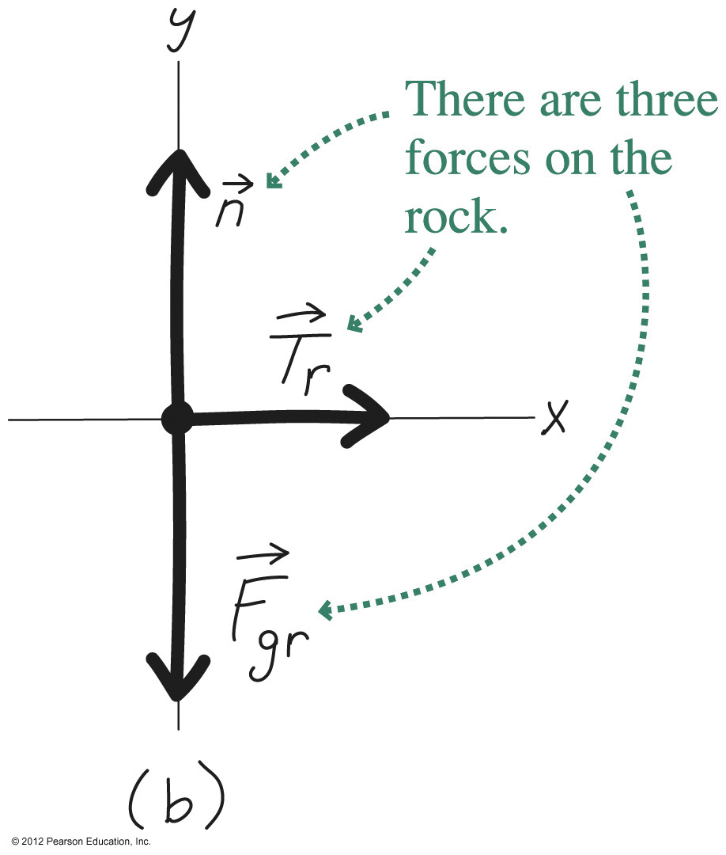
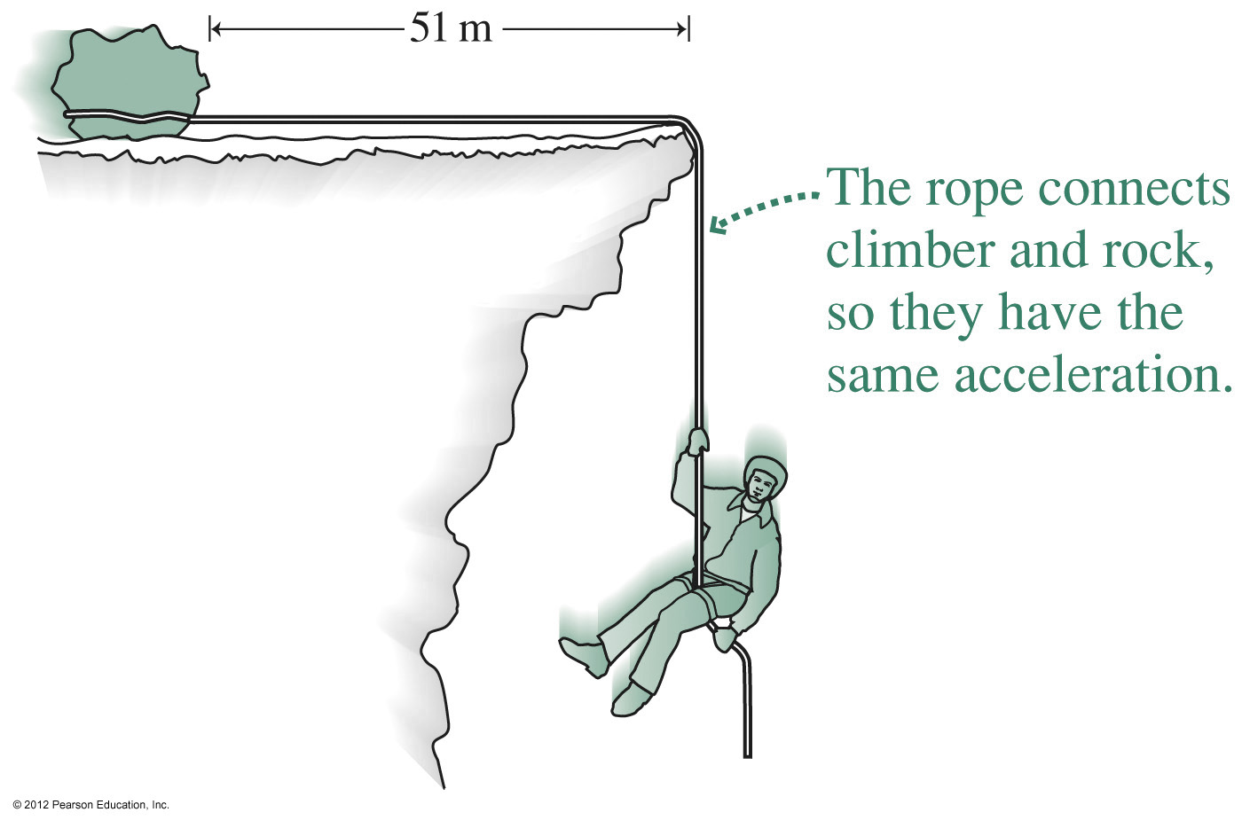
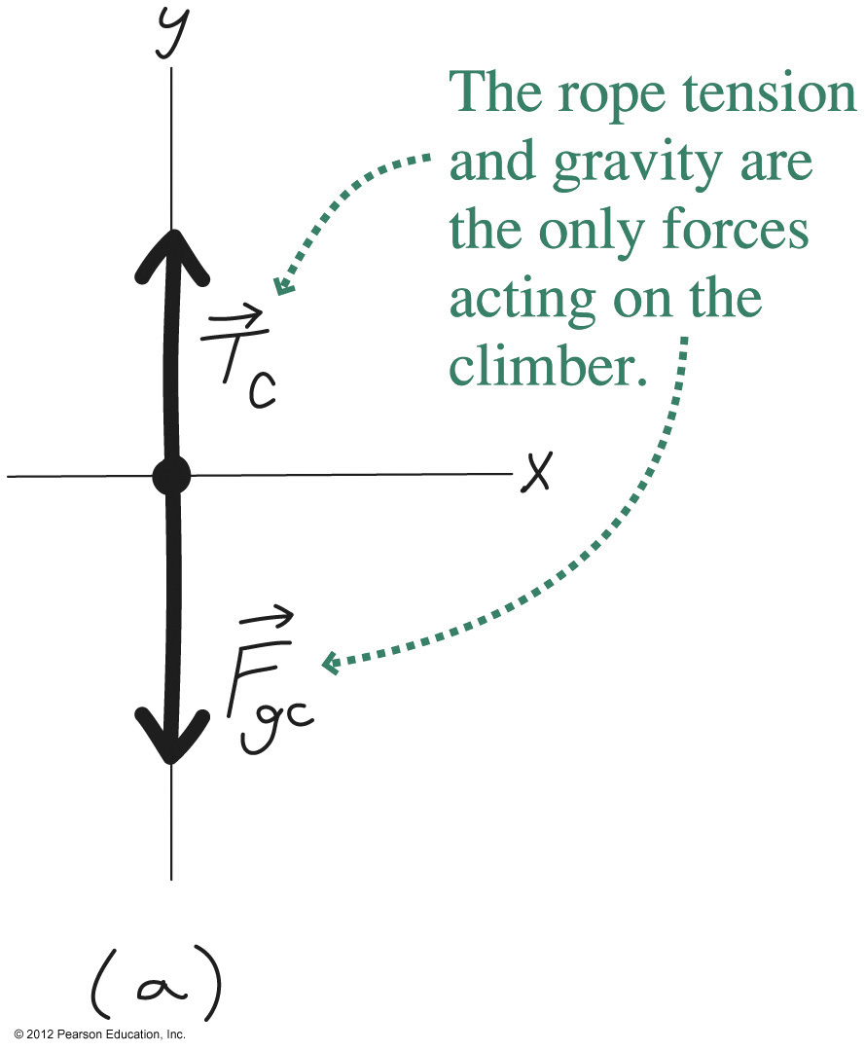
Multiple Objects
Solve problems involving multiple objects by first identifying each object and all the forces on it.
Draw a free-body diagram for each (frictionless).
Write Newton’s law for each.
Identify connections between the objects, which give common terms in the Newton’s law equations.
Solve.
Newton’s law:
In components:
Solution:

Slide 8
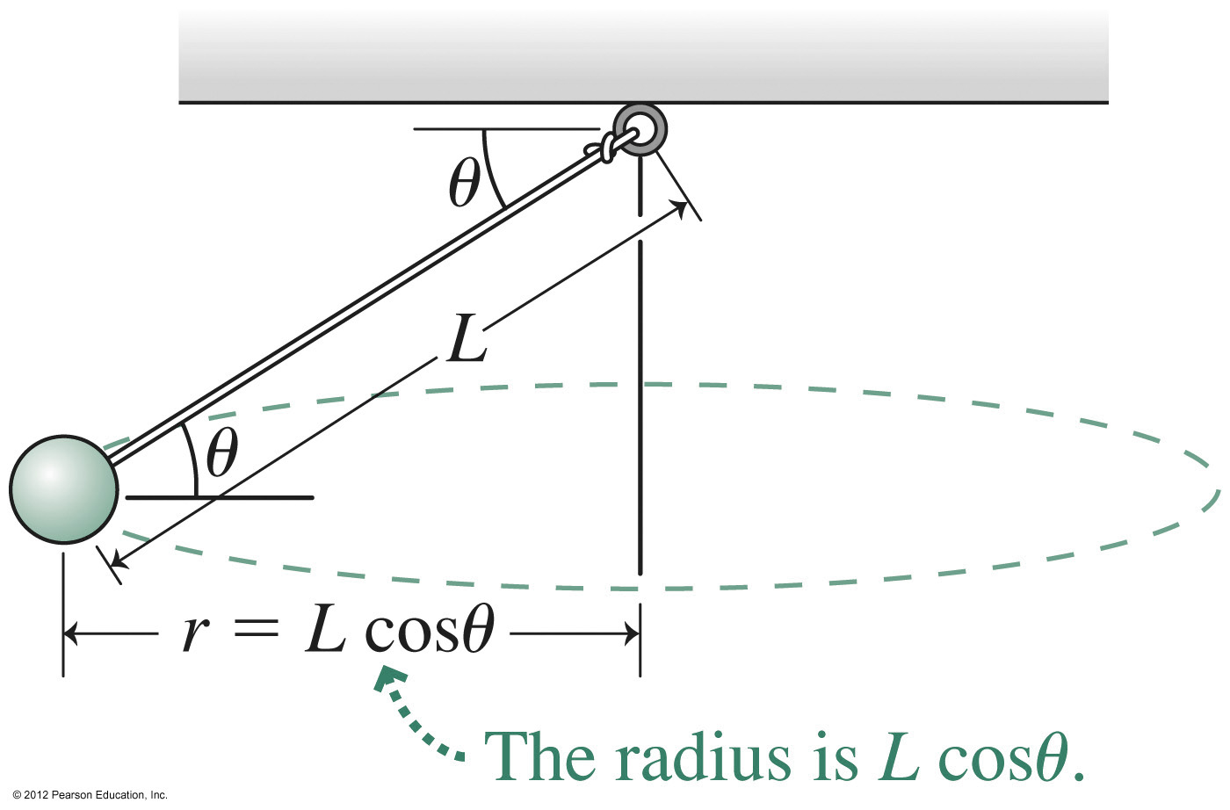
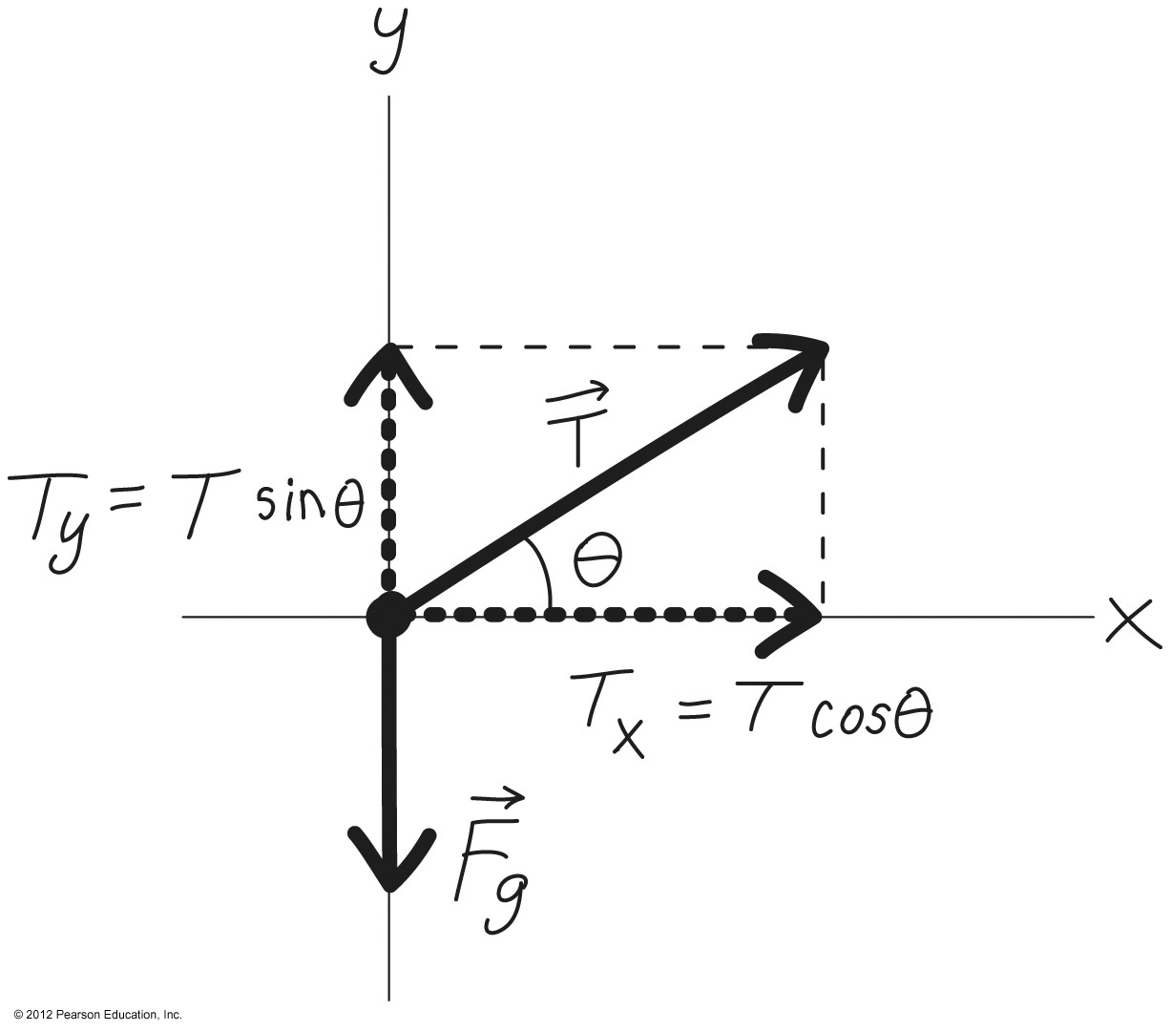
Circular Motion
Problems involving circular motion are no different from other Newton’s law problems.
Identify the forces, draw a free-body diagram, write Newton’s law.
The magnitude of the centripetal force on an object of mass m in circular motion with radius r is
the acceleration has magnitude v²/r and points toward the center of the circle.
Newton’s law:
A ball whirling on a string:
Free-body diagram:
In components:
Solve for the ball’s speed:

Slide 9
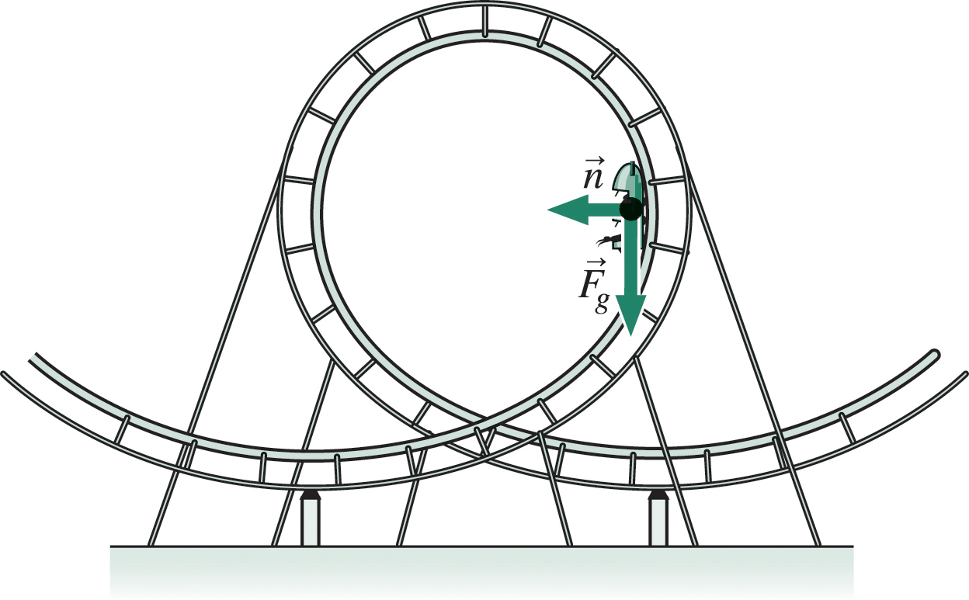
Loop-the-Loop!
The two forces acting on the roller-coaster car are:
gravity
normal force
Gravity is always downward, and the normal force is perpendicular to the track.
At the position shown, the two forces are at right angles:
The normal force acts perpendicular to the car’s path, keeping its direction of motion changing.
Gravity acts opposite the car’s velocity, slowing the car.
The net force is not toward the center

Slide 10
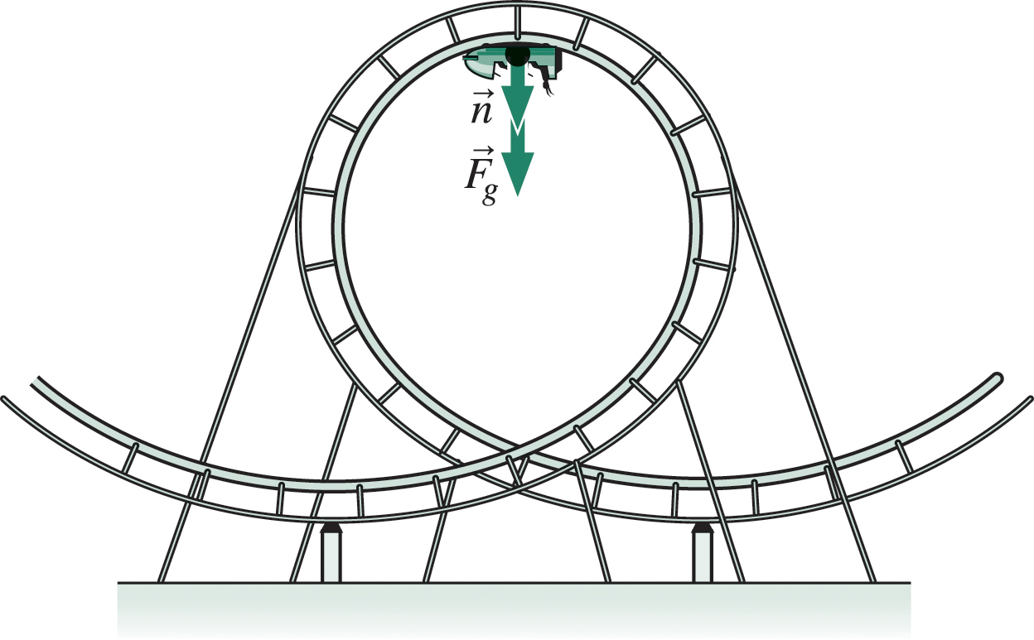
Loop-the-Loop!
At the top of the loop, both forces are downward:
Solving for v, we obtain
For the car to stay in contact with the track, the normal force must be greater than zero.
So the minimum speed is the speed that let the normal force get arbitrarily close to zero at the top of the loop.
Then gravity alone provides the force that keeps the car in circular motion.

Slide 11
Loop-the-Loop!
Therefore Newton’s law has a single component, with the gravitational force mg providing the acceleration v²/r that holds the car in its circular path:
Solving for the minimum speed at the loop top gives
Slower than this at the top, and the car will leave the track!
Since this result is independent of mass, car and passengers will all remain on the track as long as

Slide 12
Contact Forces & Friction
Normal force and Friction are contact forces
f = μN
μ_{：friction coefficient.}
m₁

Slide 13
Two types of friction
m
f
F
f_{s} = μ_{s}N (at max)
μ_{s：friction coefficient}
_{s = staticic}
f
f
m
F
μ_{k}
f
m
F
F

Slide 14
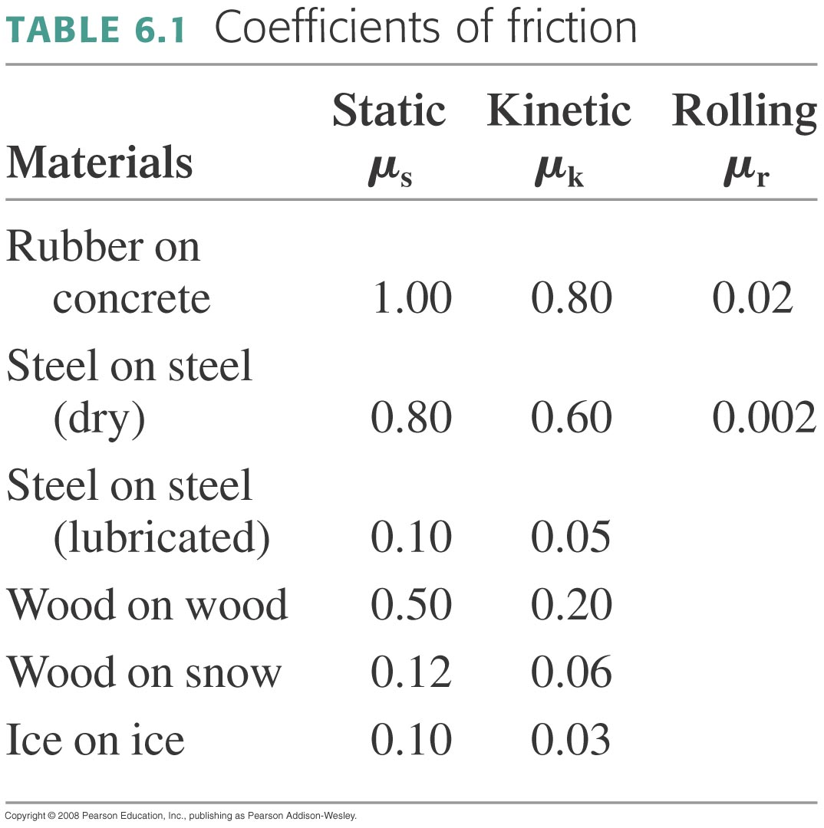
Coefficients of Friction

Slide 15
Determine the Friction Coefficients
μ_{s}
μ_{k}
m
m
θ
θ’

Slide 16
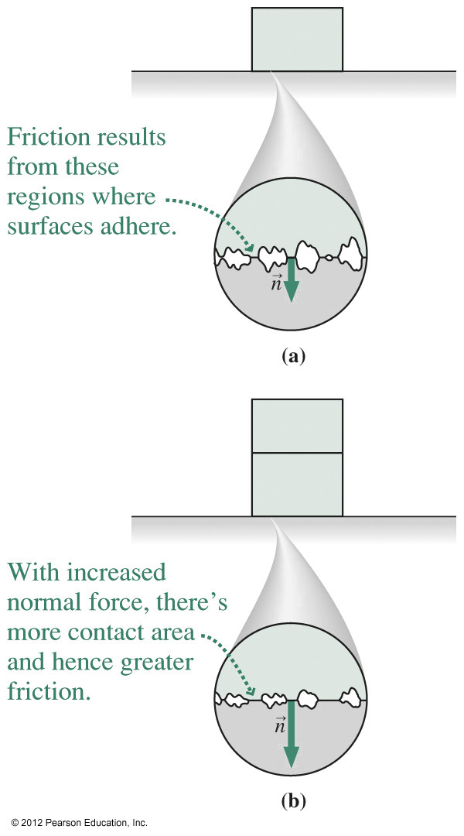
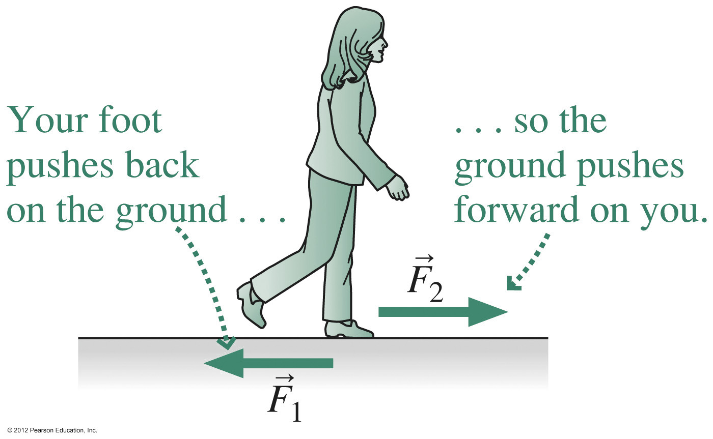
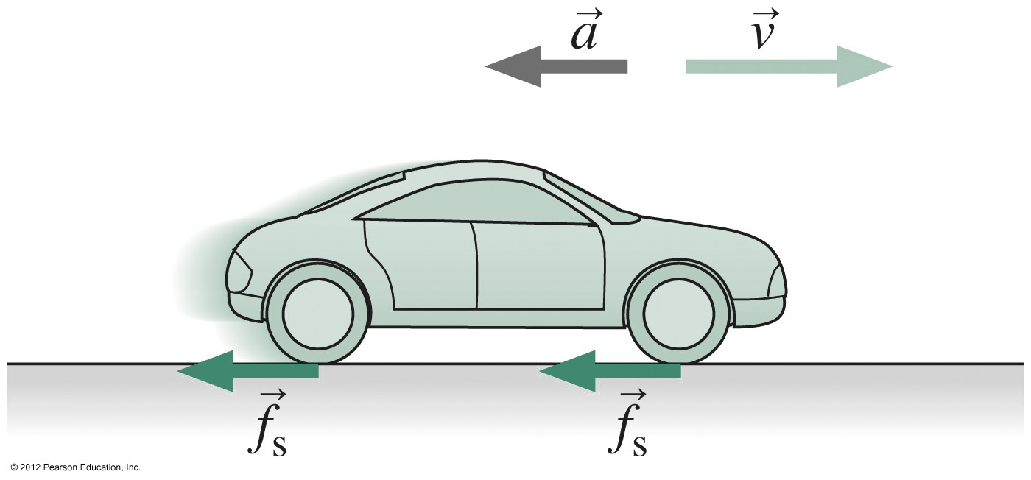
Friction
Friction is a force that opposes the relative motion of two contacting surfaces.
Static friction occurs when the surfaces aren’t in motion; its magnitude is f_{s} ≥ μ_{s}n, where n is the normal force between the surfaces and μ_{s} is the coefficient of static friction.
Kinetic friction occurs between surfaces in motion; its magnitude is f_{k} = μ_{k}n.
Friction is important in walking, driving and a host of other applications:

Slide 17
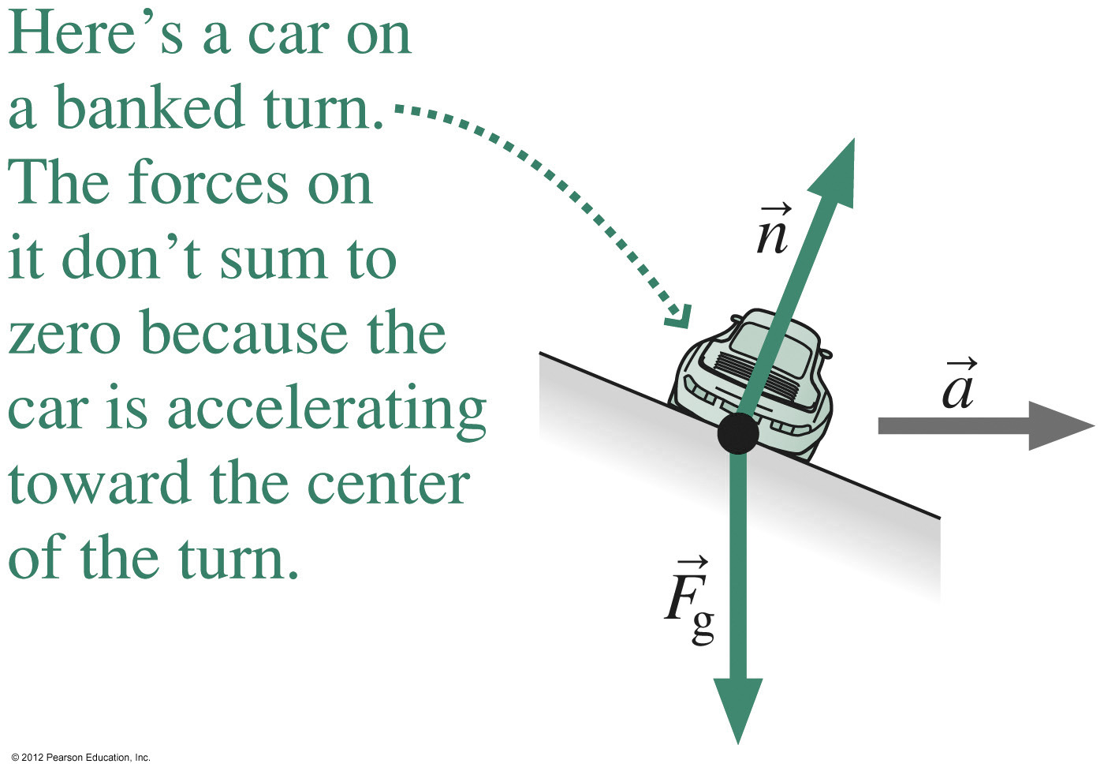
Friction is not Enough
At what angle should a road with 200m curvature radius
Be banked for travel at 90km/h (25m/s)
Notes:
Chapter 5, Summary 1, pg 80

Slide 18
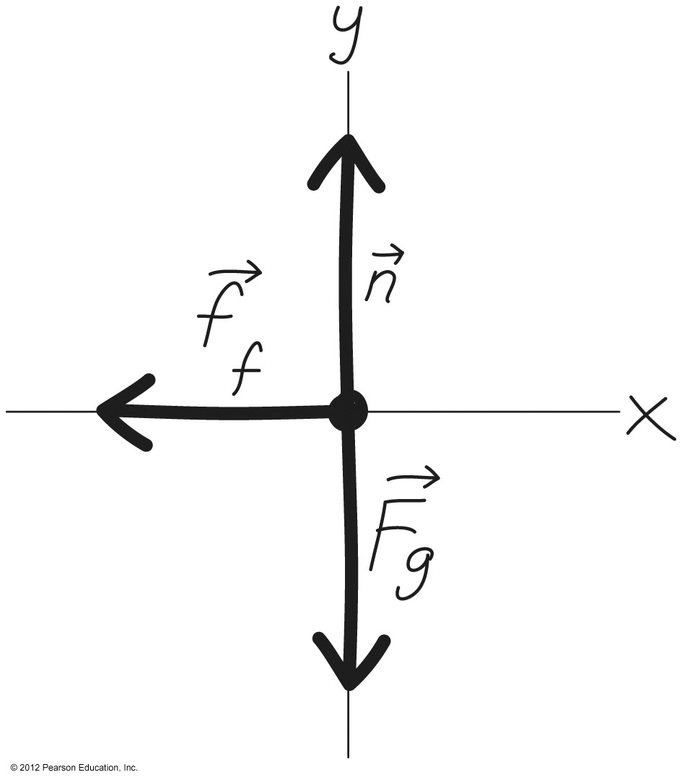
Solving Problems with Friction
Problems with friction are like all other Newton’s law problems.
Identify the forces, draw a free-body diagram, write Newton’s law.
You’ll need to relate the force components in two perpendicular directions, corresponding to the normal force and the frictional force.
Example: A braking car: What’s the acceleration?
Newton’s law:
In components:
Solve for a:

Slide 19
Problems with Friction: Examples
m
m
m
M

Slide 20
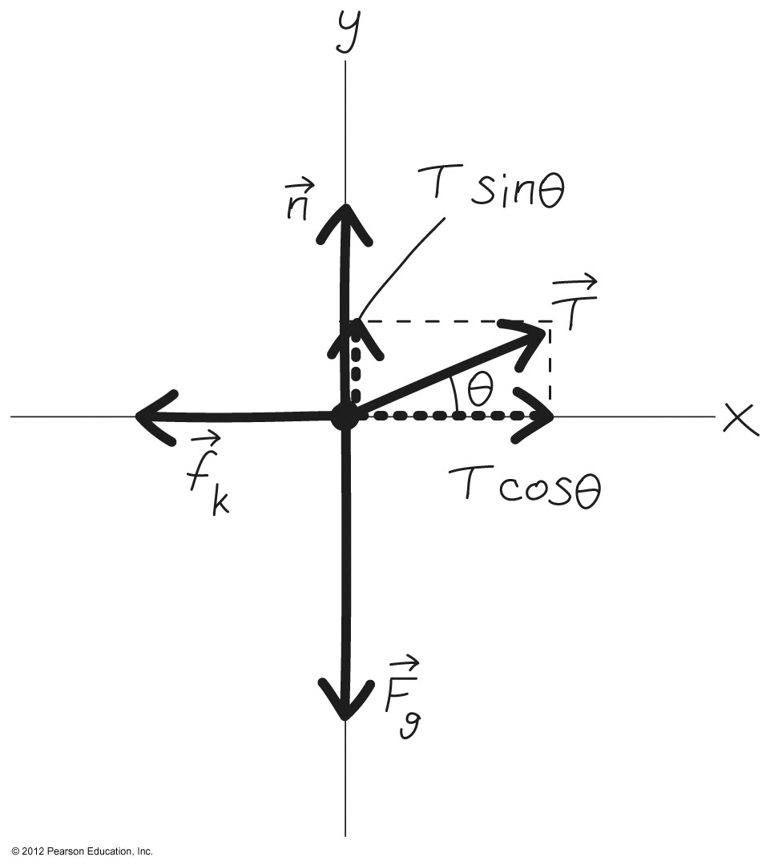
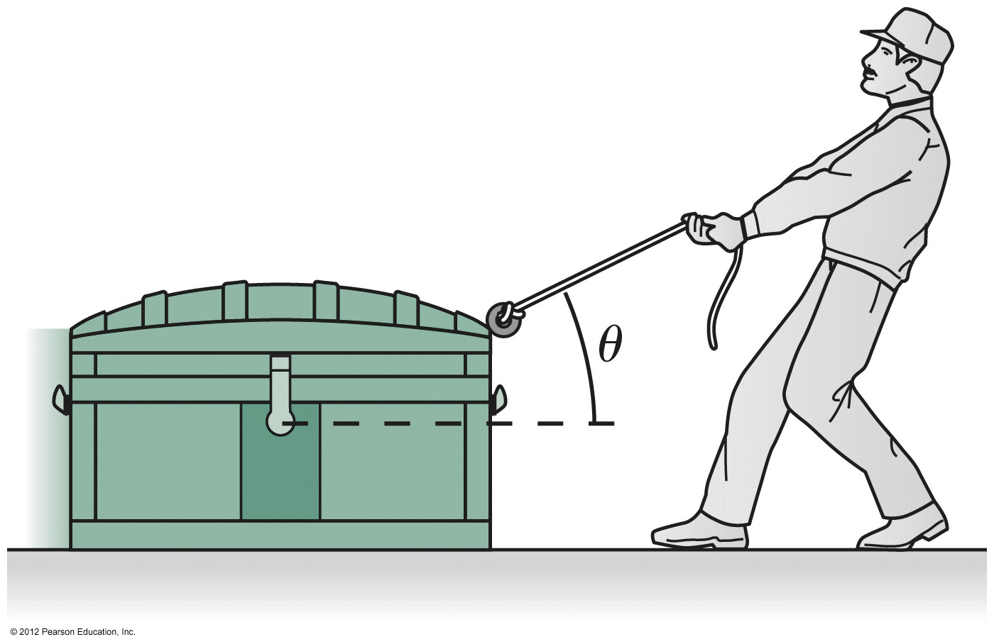
Free Body Diagram with Friction: Example
Notes:
Chapter 5, Figure 5.27

Slide 21
Free Body Diagram

Slide 22
Elastic Forces
F_{Spring} = -kx
f: force constant
x: elongation or compression

Slide 23
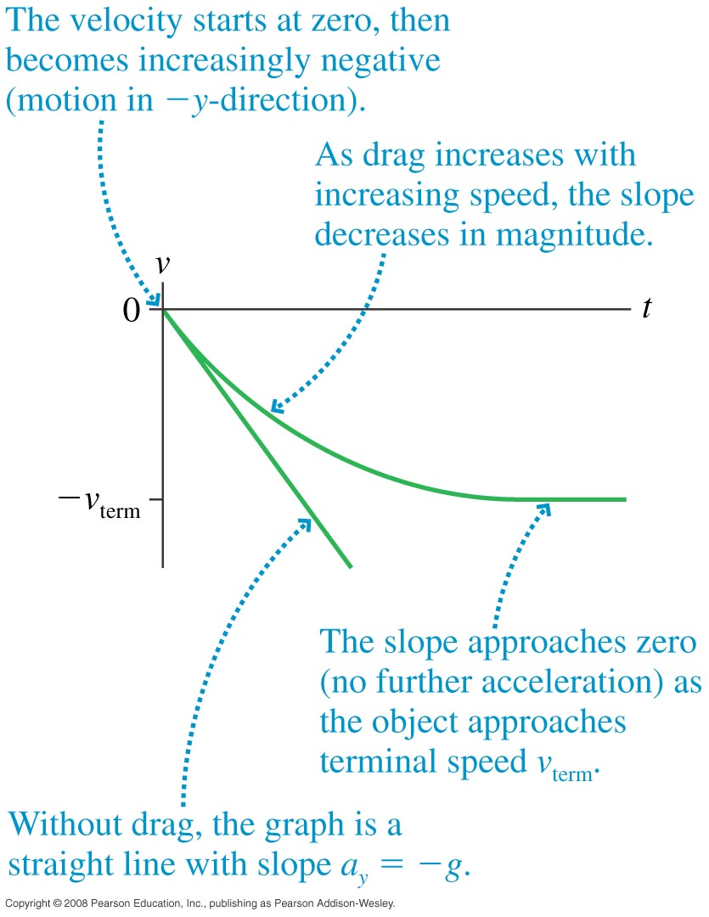
Drag Force &Terminal Speed
Drag force
Terminal v
A: cross section area
v: velocity
mg: gravitational force

Slide 24
Summary
Newton’s laws are a universal description of motion, in which force causes not motion itself but change in motion.
All Newton’s law problems are the same.
They’re handled by
Identifying all the forces acting on the object or objects of interest.
Drawing a free-body diagram.
Writing Newton’s law in vector form:
Equating the net force to the mass times the acceleration.
Establishing a coordinate system.
Writing Newton’s law in components.
Solving for the quantities of interest.

Slide 25
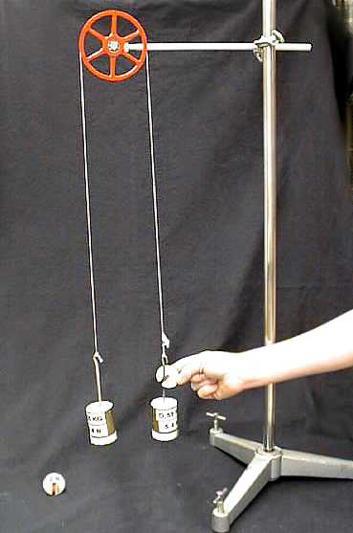
Atwood Machine—Lab on Thursday

Slide 26
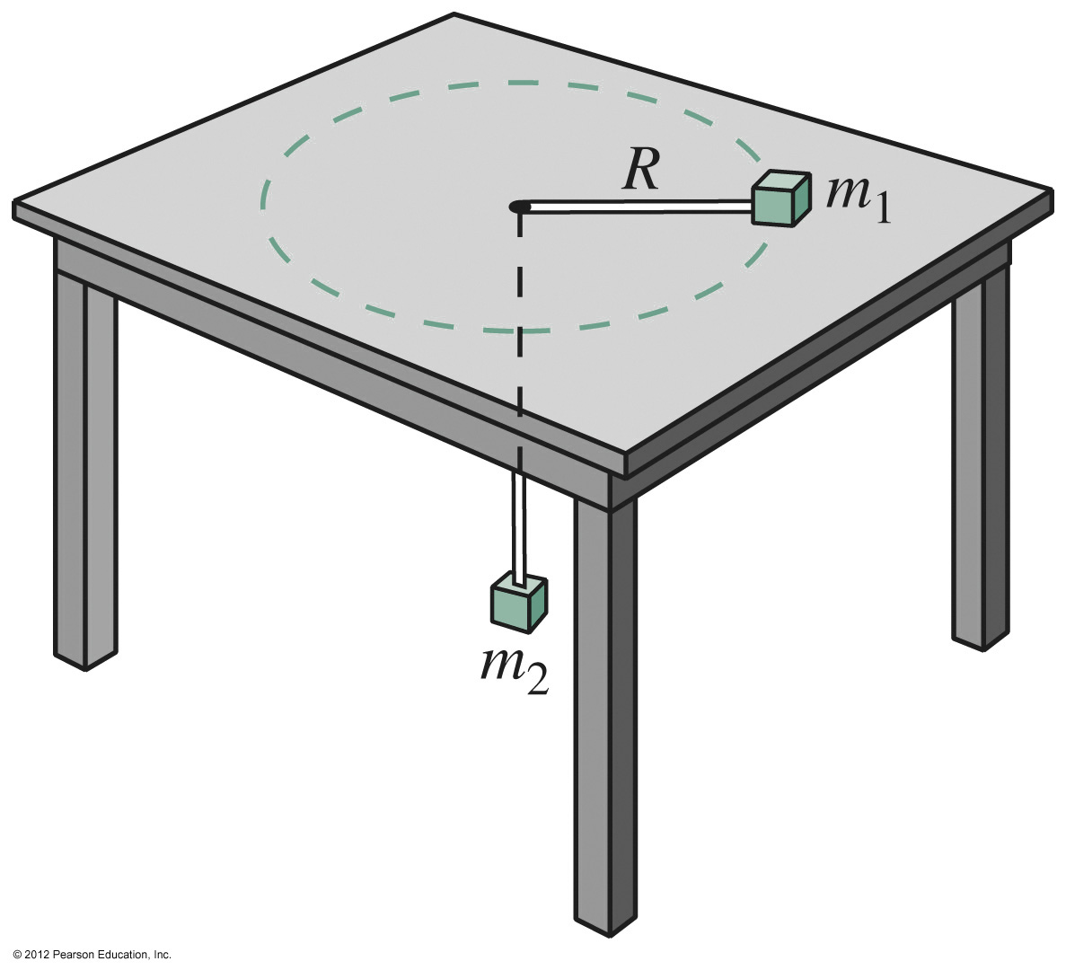
Circular Motion—example

